Slide 1
OTM M1080
Plant Solutions – Control Staff
Xiaohui Wan
Function Leaders: L.Wang / J.Xie /A.Clement / H.F.Wang /Q.S.Liu
Notes:
Template of Project report in PSC for PPR (Project Progress Review)

Slide 2

PMP Exec Summary
UVP | Ethernet technology Simple and cost effective EU durability and robustness levels
Benefits | Just enough IO and control, Customer will pay for what he needs Massive distributed intelligence, Improve local availability of system Integrated SW (Unity) for all PLC ranges needed, optimize efficiency and cost of system
Revenues | For MDI step2.1a, 12.5 M€ per year (the 3rd year forecast) without pull-through MDI step2.1b is under investigation
Potential Applications | Applications for MDI PlantStruxure child, distributed, or standalone CPU for Concentrating Solar Power (CSP) applications WWW (filter, pump control, small substation), transportation( subway BAS system, tunnel control, traffic light control), F&B(Small stand alone pipeline), power(hydro power: small speed governor, subcontrol), heating network(pump station).
Key Countries & applications | Long-term: Worldwide, in target EU verticals Short-term: Concentrating Solar Power (CSP), in Spain mainly

Slide 3

M1080 Controller will be :
The Programmable Automation Controller of the solution
  The preferred controller for some application
  The perfect child or auxiliary controller of our Process Controller &PLCs
An unique controller for CSP and other application
  Mainly sell in project mode
  Will focus on the application with fixed IO configurations with large turnover
An entry level controller to enhance Plant solution PAC platform
  Optimized controller for small application or auxiliary control
  Cost effective solution with Ethernet technology

Slide 4
Business and application
Step 2.1a
  Focus on CSP application
  Two references, one for “Tower”, the other for “Parabolic”
  Forecast:
    PAM will increase from 0.6 to 70 Giga Watts within 10 years, that means CAAGR > 45%
    It assumed that SE will keep current leading position and market share
Step 2.1b
  Opportunities for small I/O counts and similar I/O mix application
  Fixed I/O, no extension
  Candidates:
    China: Infrastructure (Tunnel: 1K/year, Subway: 4K/year), WWW (Filter control: 2K/year)
    HQS (2K/year, Duration: 4~5 years, need AC Dig channels)
    RTU (3~5k/year, with modular approach)
Year | Year + 0 | Year + 1 | Year + 2 | Year + 3 | Year + 4 | Year + 5
Units | 10,000 | 20,000 | 30,000 | 50,000 | 80,000 | 120,000

Slide 5
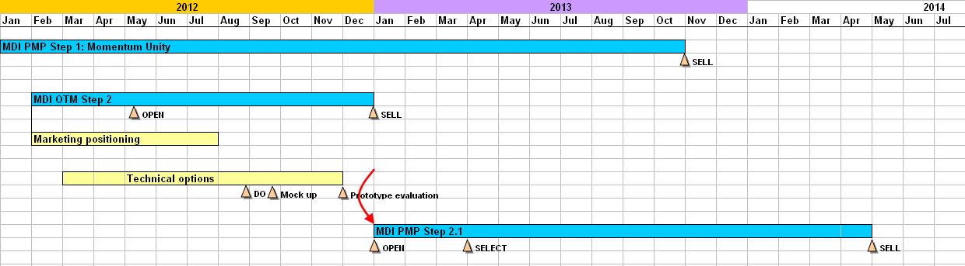
Potential projects for MDI step2.1a
Kaxu solar two
6000, mid 2013
PS400
21908
Quarzazete
800, beg 2013
Cobra
10000, 2014
MST85
7500

Slide 6

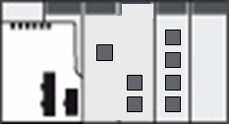


Step 2.1a architecture
Up level Redundant network
Communication upstream
  Ethernet Ring (40 devices in total):
    2 M340 as concentrator
    38 MDIs control heliostats
Communication interfaces for Devices
  CANopen: VSD (ATV312)
  Serial: Inclinometer
M340
M340
MDI
MDI
Inclinometer
MDI
MDI
VSD
2 M340 as concentrator,
38 MDI controller in one RSTP ring

Slide 7

Macro requirement of step 2.1a
Platform | Mx80 range, Unity controller
Upstream Communication | * Dual Ethernet port (Daisy chain) * USB HMI
Downstream Communication | * CANopen master * Modbus serial master
Terminal Port | mini USB
Embedded IO | 8DI, 8DO, 2HSC and 4AI (only for Parabolic)
Task and processing | * 1 Mast task, 1 Fast task * IO and Timer Event (TBD) * SR section
IO organization | State Ram, Device DDT, IODDT(TBD)
Data Exchange | Implicit and Explicit exchange
Ethernet Service | Comply to TR service * FDR cliet regular * DHCP/BOOTP * RSTP * SNMP * Modbus TCP server
Innovation | MSU (Mass software upgrade)
CCV (Eur) | * 150(Without analog channels) * 180(With analog channels)

Slide 8
Macro requirement of step 2.1b
Platform | Mx80 range, Unity controller
Upstream Communication | * Ethernet (Single or Dual ports) * Wireless (for RTU) * USB HMI
Downstream Communication | * CANopen master * Modbus serial master/slave
Terminal Port | mini USB
Embedded IO (candidates) | * 8DI/8DO, 8DI/8DO/4AI/2AO, * 16DI/16DO, 16DI/16DO/4AI/2AO (w/ 6DI configurable as 2HSC) * 32DI/16DO, 32DI/16DO/4AI/2AO (w/ 6DI configurable as 2HSC)
Task and processing | * 1 Mast task * 1 Fast task, IO and Timer Event (TBD) * SR section
IO organization | State Ram, Device DDT
Data Exchange | * Implicit exchange * Explicit exchange (TBD)
Ethernet Service | Comply to TR service * FDR cliet regular * DHCP/BOOTP * RSTP (TBD) * SNMP * Modbus TCP server/client * EIP (TBD) * Other RTU protocols and services

Slide 9
OTM Project Plan
Notes:
Template of Project report in PSC for PPR (Project Progress Review)

Slide 10
OTM Objectives
The OTM Project goal is to prepare, for the future PMP M1080:
  Structuring Marketing data and requirements
  System and product Architecture
  - Keypoints study (resulting in an Architecture "Product Concept Option" document)
  - HW / Mechanical / FW / SW Prototypes to validate points and providing base for PMP development and first integration

Slide 11

Project Scope
Sync with
MDI step 2.3
General propose offer – entry level Unity PLC portfolio
Focus on
MDI step 2.2
Key strategic segments – WWW, infrastructure, RTU?
MDI step 2.1b
Short term opportunity – WWW, MMM, HVAC apps?
Partial Micro subs.
MDI step 2.1a
Short term opportunity -- CSP project only
2015…
2014/15
Integr. Distri. Ctrl
Modularity
2013/14
Mx80 range

Slide 12
OTM Project Schedule
Due to resource limitation, PMP 2.1 OPEN will at the beginning of 2013

Slide 13
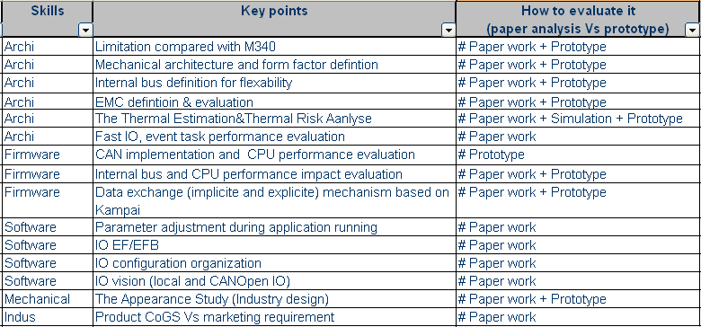
Project Main Key points list

Slide 14
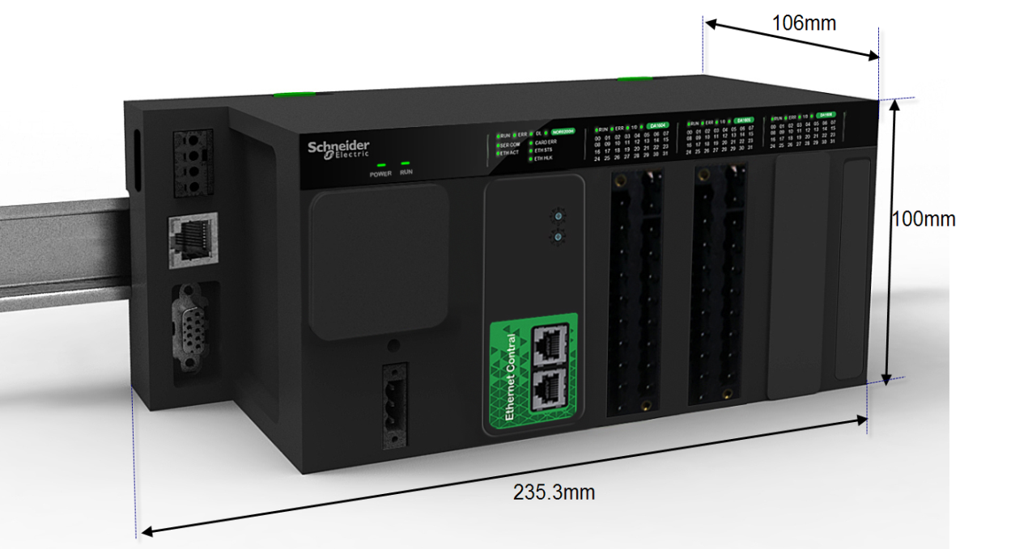
Key proposal: Mechanical form factor
Compact box PLC
High end product image
  M340 similar form factor
  Black color
  Triangle design
  Robustness felling
Maximum reuse M340
  Reuse led board
  Reuse terminal block
More flexibility
  More space for communication board to integrate different function
  Easy exchange different I/O
  Flexible in tooling design to meet different configuration
SD & USB-B
LED
SL1
SL2
CANOPEN
PS
Communication
I/O board

Slide 15
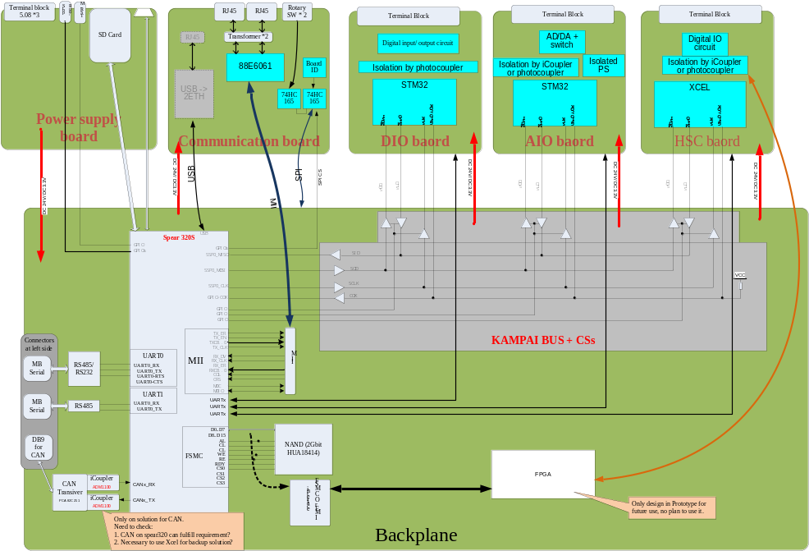
Key proposal: Hardwar architecture
Internal module design to implement different function:Easy to reconfigure features
  Dedicated power supply board
  Combine CPU and backplane in one board
    Reduce cost, Improve thermal performance
  Dedicated communication board to reserve PCB space to extend different functions.
  Different I/O board to implement DI/O , AI/O and HSC function.
Internal communication bus selected: Kampai + UART
  Low cost solution
  Maximum support 4 I/O board
  Reserved UART for event task
Multi interface reserved for communication board to support different function integration
  MII for ETH
  USB-A
  Kampai

Slide 16
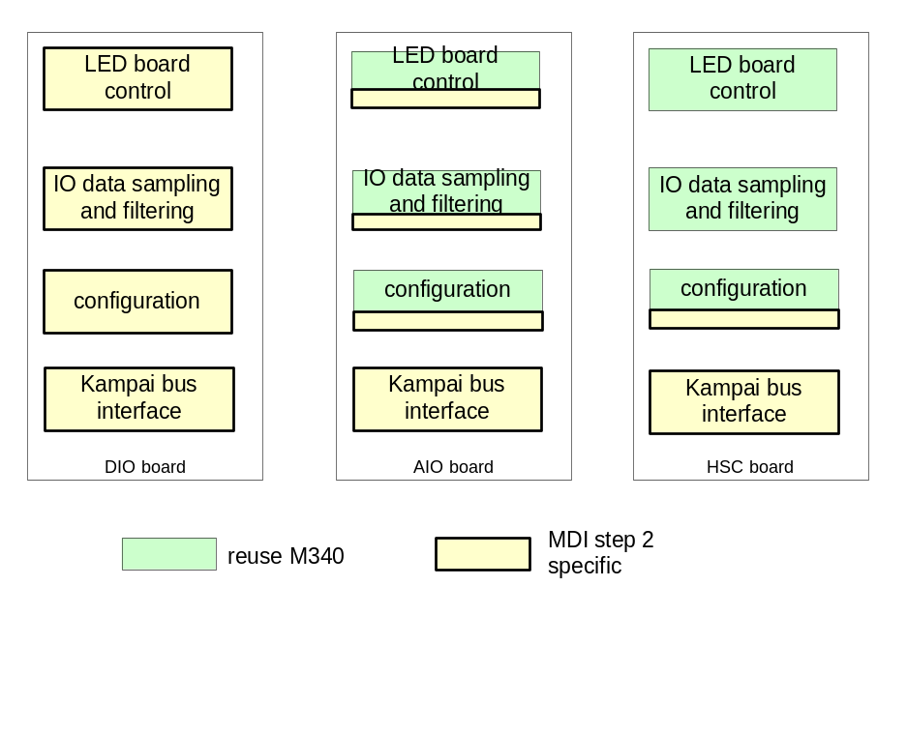
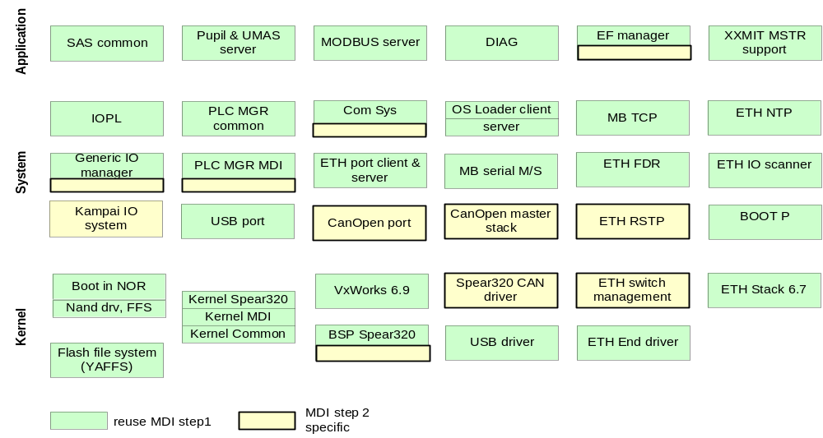
Key proposal: FW architecture
Spear320s FW
IO board FW

Slide 17

Prototype definition
HW/Mech
  Communication
    2 ETH (2 rotary switch)
    1 CAN via CPU
    2 RS485/232 (isolation)
    1 USB device
    1 USB to 2ETH switch
  Misc.
    1 SD card
    RTC
  PS
    24VDC@25W
  IO board
    2 channel HSC
SD & USB-B
LED
SL1
SL2
CANOPEN
PS
Communication
I/O board

Slide 18
Prototype definition
FW
  CPU
    Download app from ETH
    Fix IO configuration
    Kampai IO system
    Kampai master
    UART
    Explicit exchange (EF/EFB,EF manager, system service)
  IO board
    Kampai slave
    UART
    LED control
    Explicit exchange (Kampai cmd support)

Slide 19
MSU
MSU function may include different levels
  User application program
    Check user application program version
    Upgrade user application program
  PLC firmware
    Check CPU/IO board FW version
    upgrade CPU/IO board FW
  Store/restore user-defined parameter (IP adress, I/O configuration, etc.)
    Customer can store PLC parameter and may modify the parameters offline.
    Customer can update PLC parameters easily with restore function

Slide 20
OTM Staffing
Position | Name | Team
OTM project leader | Xiaohui-Robin Wan | AOC-C / PMO
Marketing leader | Lei-Leo Wang | AOC-C / PlantSolutions IO marketing
OTM project design leader | Jian-James Xie | AOC-C / OTM & Architecture
HW architecture | Richard Tonet | PlantSolutions Control / Platform Design
HW architecture | Jean-Jacques Adragna | PlantSolutions Control / Platform Design
Firmware architecture | Jacques Piacibello | PlantSolutions Control / OTM Platform Design
Hardware leader | Jian-James Xie | AOC-C / OTM & Architecture
Firmware leader | Haifeng Wang | AOC-C / OTM & Architecture
Software leader | Arnaud Clement | PlantSolutions Control / End User Software
Mechanical leader | Qi-Steven Liu | AOC-C / Plant Solution Platform & H2I Design
Industrialization leader | Ming-Allen Sun | AOC-C / Industrialization
Purchasing leader | Weihua Huang | AOC-C / Purchasing

Slide 21
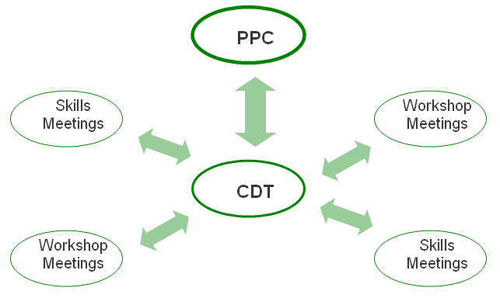
OTM Project Communication
Skills and workshop meetings report to the Project CDT
Project Leader report monthly at PPC
The base information exchange media are
  Minutes
  OTM Dashboard
  Emails exchanges
Each skill has its own synchronisation entities
  Marketing
  Hardware
  Firmware
  Software
  Mechanical

Slide 22
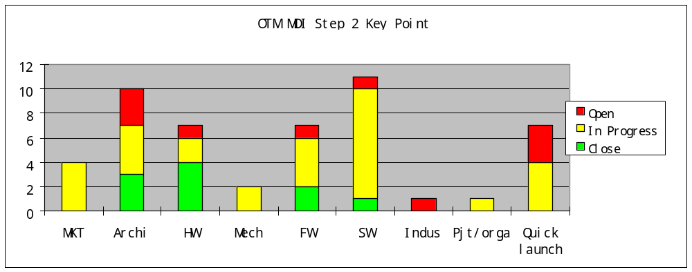
Project
Key point status
Notes:
Present the current risk estimation and changes.
Prepare expected decisions from the PSC. Present a synthesis for decision making, and don't spend too much time on details. When needed, bring additional slides for a back up presentation in case of questions from the PSC.
Present the expected results for the next month.

Slide 23
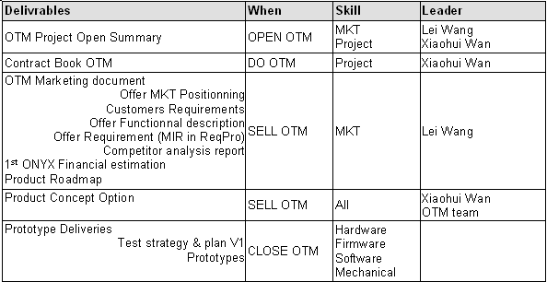
OTM deliverables

Slide 24
Question / Decision
?

